Slide 1
Introduction to Fastlane
And Auto Packing
Gianscal Yu 2018.03.13

Slide 2
What Is Fastlane?
Fastlane is a tool for iOS and Android developers to automate tedious tasks
generating screenshots
dealing with provisioning profiles
releasing your application
Today we only talk about auto pack iOS
Archive build iOS ipa file
Upload ipa to Distribute Platform

Slide 3
Why Use Fastlane?
Promote working efficiency
Do not need to configure complex xcodebuild script parameters
Debugging issue that can only reproduce in releasing condition
Delivering ipa or apk to test team for testing work
Release production package

Slide 4
How To Use Fastlane?
Under the configured ruby code
- fastlane
- fastlane [ios/android] [command]

Slide 5
Environment Configuring
Ruby Environment :
https://www.jianshu.com/p/78e324a4962c
Setup Fastlane :
xcode-select --install
sudo gem install fastlane --verbose
Fir.im Command Line Tools :
sudo gem install fir-cli
fir login b0bf2c0b276854ab0edf42f992b394d4

Slide 6
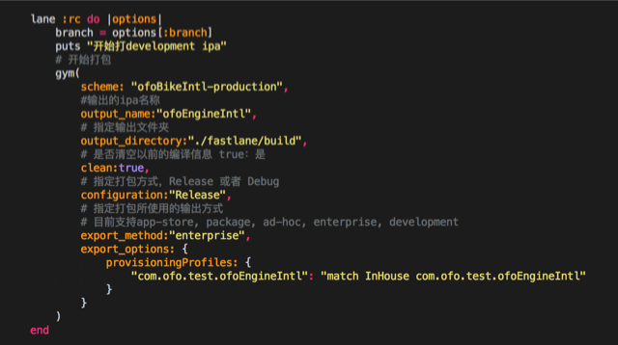
Script Build Up

Slide 7
Fir.im & Pgyer Upload
Fir.im
fir publish ${ipa_path} -T "XXX_YOUR_API_TOKEN_XXX" -c "${commit_msg}"
Pgyer
fastlane add_plugin pgyer
pgyer(api_key: “#{api_key}”, user_key: “#{user_key}”)

Slide 8
Yarn & Python Integration
Python:
using sys command
Yarn Tools:
Package.json
"pack-ios": "python ./scripts/pyTools/pack_ios.py"

Slide 9
Thanks!

